Slide 1

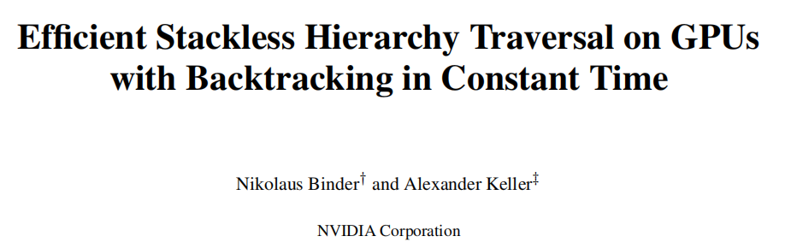
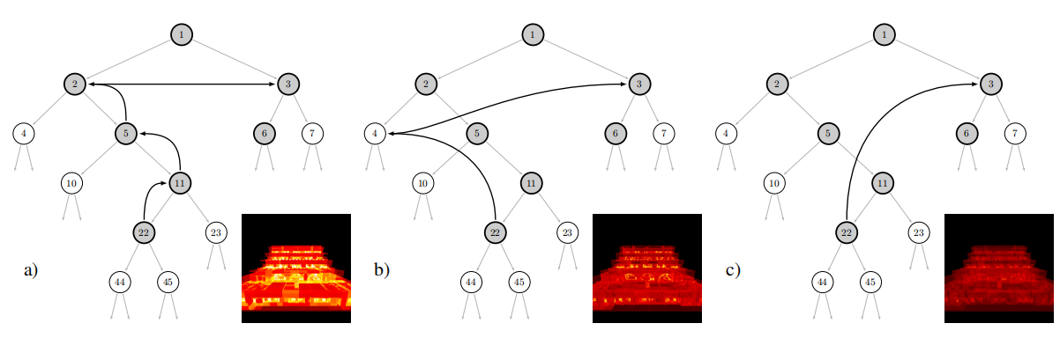

Slide 2
OutLine
Introduction
Backtracking in Constant Time
Perfect Hashing
Parallel Construction of Hash Tables
Disjoint t-Intervals Mask
Pausing and Resuming

Slide 3
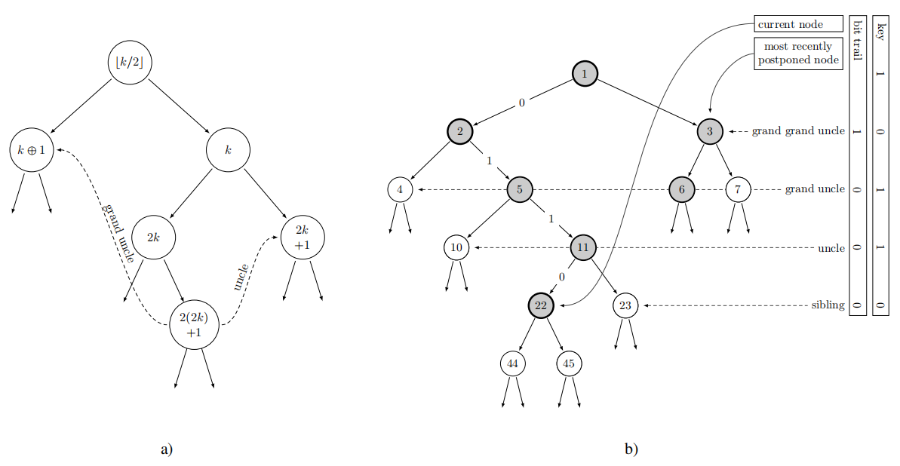
Backtracking in Constant Time

Slide 4
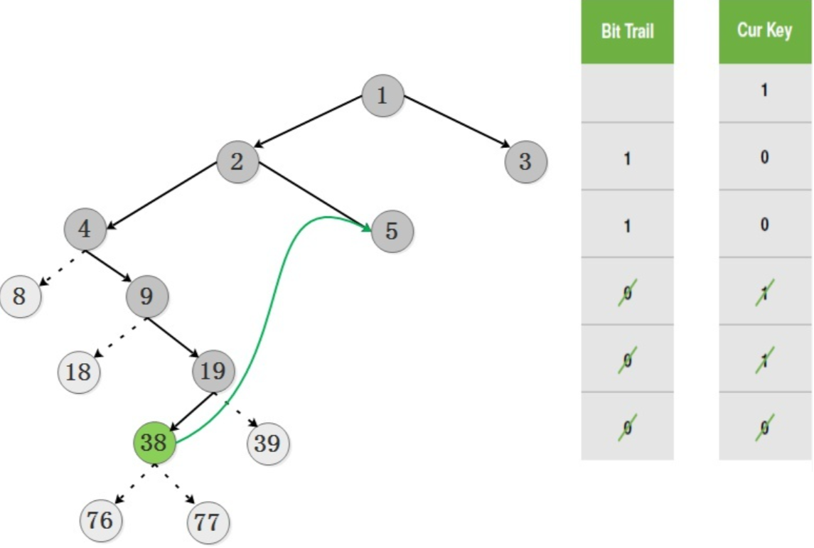
Backtracking in Constant Time
4
(100)2
5
(101)2
38
(100110)2
38>>3
(100)2

Slide 5
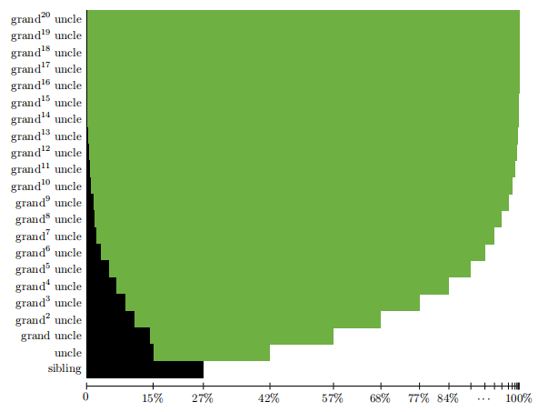
Backtracking in Constant Time

Slide 6
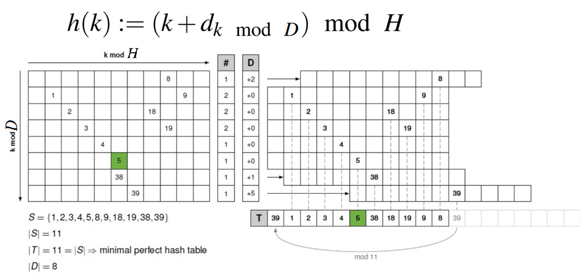
Perfect Hashing

Slide 7
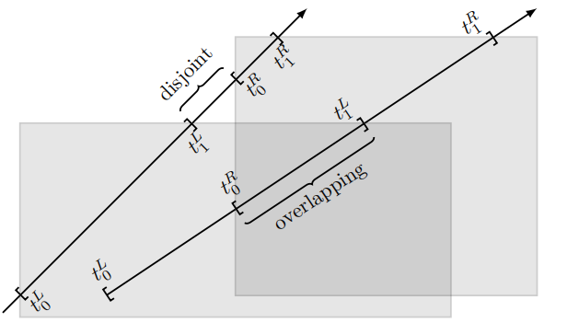
Disjoint t-Intervals Mask

Slide 8
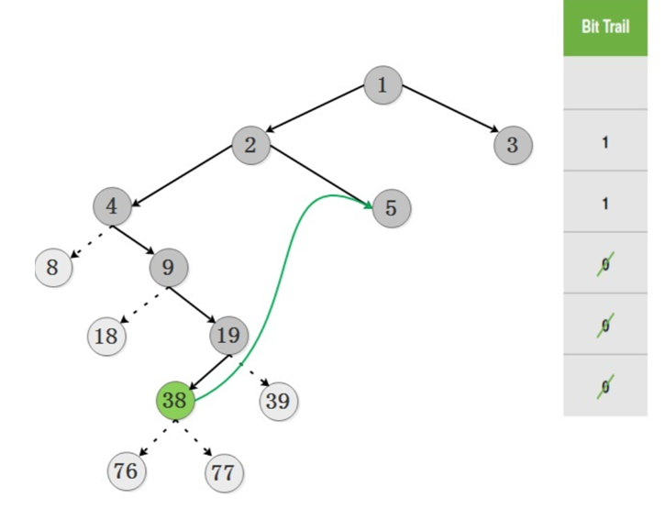
Disjoint t-Intervals Mask
bitTrail &= disjointIntervalsTrail
(bitTrail & -bitTrail) & disjointIntervalsTrail
disjointIntervalsTrail
1
0
bitTrial=(10010)2
lowbit(.)=(10)2

Slide 9
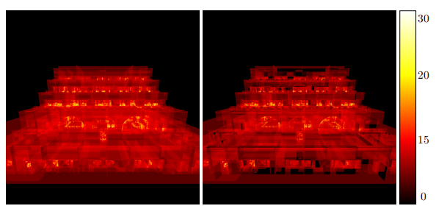
Disjoint t-Intervals Mask

Slide 10
Thanks for listening !

Slide 12
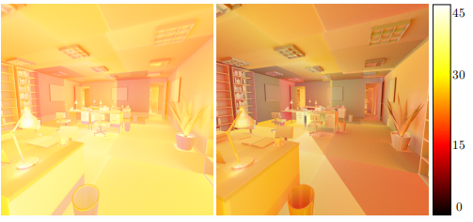
Performance

Slide 13
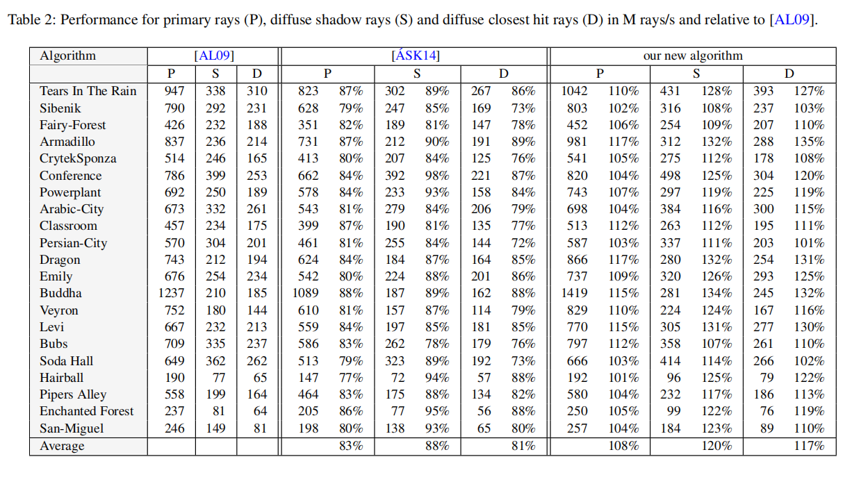
Performance

Slide 14
Thanks for listening !

